Slide 1


Slide 2

Our universities – A picture of inequality
FEES
MUST
FALL

Slide 3
Who is in the system?
2000 | 15 years of inequality | 2014
560 000 | University enrolments | 980 000
89 000 (16%) | Number of beds (est.) | 205 000 (21%)
9,90% | Participation rates – blacks | 15%
50% | Participation rates – whites | 57%
R27 600 | Government cost per student | R23 600
FEES
MUST
FALL

Slide 4
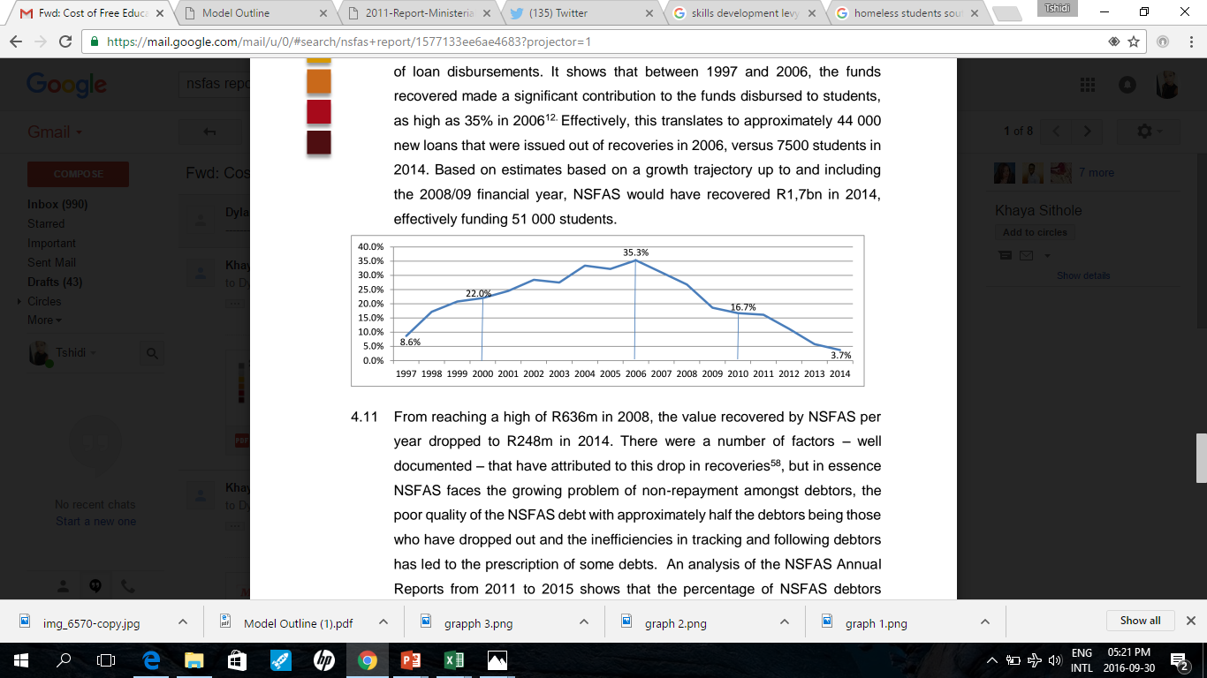
Our universities – NSFAS & poor collections
Convertible loan system aimed at poor students
2 phases – TEFSA (until 1999); NSFAS – since 1999
Associated with the black tax phenomenon
Suboptimal performance – administration, limited coverage
FEES
MUST
FALL

Slide 5
#FeesMustFall – 2015 – the trigger
2015 | UCT | Wits | LIMPOPO | AVERAGE
Tuition Fee
Full cost of study
2016 – increase 10.5%
FEES
R52 000
R49 000
R29 000
R34 000
MUST
FALL
R113 600
R99 500
R69 500
R74 820
R125 530
R109 950
R76 800
R82 700
NSFAS Cap |  |  | R67 200
Average annual black household income |  |  | R101 000

Slide 6
Who charges what?
FEES
MUST
FALL

Slide 7
Full cost of study (FCS) comparison
FEES
MUST
FALL

Slide 8
A history of escalating costs, declining subsidies
FEES
MUST
FALL

Slide 9
A history of escalating costs, declining subsidies
FEES
MUST
FALL

Slide 10
Are we spending enough?
FEES
MUST
FALL

Slide 11
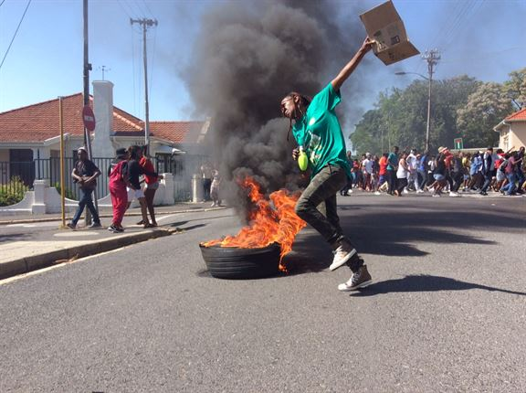
The 2016 interventions
0% increase
The Commission of Inquiry
Damages bill – R600m PLUS
Ministerial statement – 8%
Student response
Reasons
FEES
MUST
FALL

Slide 12
The 8% debate – why the rejection?
Wits University | 2015/16 Fees | 2017 Fees – 8% increase | Government contribution | Student contribution
Tuition | R40 295 | R43 520 | R3 225 | R40 295
Residence | R33 660 | R36 350 | R2 690 | R33 660
Meals | R27 400 | R29 600 | R2 200 | R27 400
Total | R101 355 | R109 470 | R8 115 | R101 355
Weaknesses | Does not address the affordability question Does not amend qualification for full access to funding platform Does not address off-statement costs (private accommodation, books and resources)
FEES
MUST
FALL

Slide 13
The proposed resolution – 3 step process
A model with buy-in from students
Step 1 – restore state subsidy to 50% of costs
The funding gap – what makes up R60 billion?
Step 2 – Corporate SA – R10 billion infrastructure fund?
Ways of capitalising the infrastructure fund
Tax policy considerations
Incentives to cater for cost of capital?
FEES
MUST
FALL

Slide 14
Unlocking collaboration – Corporate SA
The SA investment strike is a reality – hundreds of billions lie idle in corporate balance sheets
Cost structure – fixed vs recurrent
Institutional autonomy – the 3 pillars of an institution – can we shift the burden without interfering with academic autonomy?
Production of knowledge – research imperative
Dissemination of knowledge – teaching and learning
Skills transfer & community engagement
Where can ‘outsiders’ intervene?
FEES
MUST
FALL

Slide 15
The Capital Infrastructure Fund
Target variable → fixed expenditure
Characteristics of the variable – day 1 capital outlay; enduring benefits; recurrent expenditure component
Institutional backlog – infrastructure audit
Impact on delivery of programmes; absorption of qualifying students
Solution – utilisation of balance sheets
Quid pro quo – tax rebates, capital allowances
Operational mechanics – independent JV with DHET as stakeholder
FEES
MUST
FALL

Slide 16
The Capital Infrastructure Fund
FEES
MUST
FALL

Slide 17
The Education Endowment Fund – step 3
Mandate – create a self-sustaining Education Fund
Initial capitalisation – current NSFAS allocation; SETA contributions; corporate philanthropy; additional funding as advocated in this model
Design – independent structure overseen by DHET
Centralised pooling of funds; direct interactions with HEI
Replenishment – permanent collection from ALL graduates plus exit tax for those who emigrate
The students WANT TO PAY for free education – at the appropriate point which is not at student level
FEES
MUST
FALL

Slide 18
Funding the system – source of investment
Source of Income | Current Rate | Proposed Rate | Additional funding | Qualitative considerations
Skills Development Levy | 1% | 2% | R13.8 billion | Flexibility Ease of administration
Corporate Tax | 28% | 30% | R13 billion | Impact on competitiveness and FDI attraction Affects a specific cohort of taxpayers
Individual Tax | 41% | 42,5% | R3-R5 billion | In line with the ‘social justice’ imperative of taxing the rich Affects a limited tax base
Windfall Tax | NIL | -- | R26 billion | Justice tax Likely to be once-off
Wealth Taxes | 15% - 20% | 15% - 20% | Negligible | Least favourable due to minimal income
FEES
MUST
FALL

Slide 19
Funding the poor vs middle class vs wealthy
Overall philosophy – universal funding for all undergraduates
Rollout – poor, then middle class, then everyone
Recommended approach – full subsidy for the poor
Family contribution on a sliding scale in line with ability to pay as advocated in the 1997 White Paper for the middle class
Ceiling of R600 000 (matches DHET ceiling)
Collection mechanism – annuity approach on all ‘new’ graduates – triggered by SARS tax ‘participation’
FEES
FALL

Slide 20
Differentiated funding – option 1
Income level | Class | Family contribution (minimum) | Family contribution (maximum) | Subsidy funding
0 – R300 000 | Class 1 – Quintile 1 – 3 | 0 | 0 | 100% for regulation time plus 1 year
0 – R300 000 | Class 2 – Quintile 4 – 5 | 0 | 0 | 100% for regulation time
R300 001 – R450 000 | Class 3 | 20% on the excess above R300 001 | NIL on the first R300 000 PLUS 25% on the amount between R300 000 & R450 000 = R37 500 (8,33%) | Excess above family contribution
R450 001 – R600 000 | Class 4 | R30 000 PLUS 30% on the excess above R450 001 | R37 500 on the first R450 000 PLUS 30% on the amount between R450 000 & R600 000 = R82 500 (13,75%) | Excess above family contribution
Above R600 000 | Class 5 | Full cost | Full cost | NIL
FEES
MUST
FALL

Slide 21
Differentiated funding – option 2
Income level | Class | Family contribution | State contribution
0 – R300 000 | Class 1 – Quintile 1 – 3 | 0 | 100% for regulation plus 1 year
0 – R300 000 | Class 2 – Quintile 4 – 5 | 0 | 100% for regulation time
R300 001 – R450 000 | Class 3 | Excess over state contribution | 15% of family income
R450 001 – R600 000 | Class 4 | Excess over state contribution | 7,5% of family income
Above R600 000 | Class 5 | Full cost | Full cost
FEES
MUST
FALL

Slide 22
The Way Forward
State
Students
Social Stakeholders
FEES
MUST
FALL

Slide 23
Socio-economic considerations
Is it a public good?
Should the rich be accommodated?
Is higher education elitist?
Isn’t Basic Education more important?
We are already over-taxed, leave us alone
Will the country and society ever benefit?
Can this ever be implemented?
FEES
FALL

Slide 24
Public good?
Higher education is a public good with significant private benefits – costs must be shared
Recommendation – graduate levy to compensate for the cost to society
Corporate graduate levy on ALL graduates – even those who pay their own way are paying into a heavily subsidised system so they need to compensate society
Corporate graduate levy needs to be ring-fenced for higher education
Over time – burden of funding higher education shifts towards the graduates themselves rather than state – it is free education for the state and society
FEES
FALL

Slide 25
Should the rich be accommodated?
Discretionary approach – rich pay their own way but only if they send their children to local HEI (participation)
They pay for the duration of study (tenure)
They pay tuition only (limited contribution)
They pay subsidised fees (SA doesn’t distinguish between true cost (excluding state subsidy) and subsidised cost – i.e. – we are already giving them a leg up!
Alternative – accommodate them in exchange for higher taxes (long-term contribution to the system)
FEES
FALL

Slide 26
Elitist nature of higher education?
Inequalities are fundamentally prevalent in SA – Gini coefficient approaching 0.70
Funding higher education benefits a minority – we argue it is only a minority due to the existing financial barriers to access
Opening up access improves participation rates and reduces that aspect of the inequality coefficient
Long-term view – funding higher education will not be at the expense of basic education and other social (first generation rights) initiatives
FEES
FALL

Slide 27
Basic Education is a greater priority
Education system is wholly dysfunctional
Basic education’s limitations feed into higher education – both need to be addressed
We do not advocate for the reallocation of resources away from basic education
We seek to create a self-sustaining higher education system in the long-run
No part of the fix can be delayed whilst another is fixed
FEES
FALL

Slide 28
Can anyone shoulder the tax burden?
Individual tax burden at 41% - can it be increased in the short run? 42%? 43%?
Corporate tax burden – impact on FDI, economic growth, overall competitiveness
Balance needed – between fixing a social crisis with long-term benefits and the cost of disruption
Payroll taxes basket – latitude exists for an increase
Benefits to the country and society – increased education levels across the board. Social benefit indisputable
FEES
FALL

Slide 29
Implementation guideline
Current cohort – evaluate current students under new qualification rules (R300 000 test)
Roll out subsidy funding up to regulation time, no retrospective write-offs
New intake 2017 – subsidy funding across the board subject to the family contributions matrix
Rollout of centralised application platform – enable students to link academic status (including ranking) and funding status in advance (2018 intake)
FEES
FALL

Slide 30
And then they all went to UCT…
Managing population within institutions – if it’s all free then some institutions will collapse
In any model – the rich will still buy their way into the system
Need to allocate spaces to the poor and middle class in a fair manner
Recommendations – UCT Admissions policy
Wits Medical School reservations policy – for key/high-demand programmes
Ensures that poor students who qualify get access
FEES
FALL

Slide 31
And then they all went to UCT…
Enrolment plans for high-demand offerings needs constructive intervention
Long-run – incentive for staying at a local HEI?
Alignment of entrance criteria for ‘similar’ offerings?
Fixed state contribution model has 2 possible consequences –
  Middle class happy to bear the burden of the family contribution and go to UCT and pay the excess OR
  Move to an institution where the state contribution covers all their costs
FEES
FALL

Slide 32
Corporate graduate levy – the mechanics
Triggered once graduates are in the tax net – i.e.: apply existing tax thresholds
Cost to employee – similar to UIF
Recommendation – additional 1% in the first 3 brackets; additional 2% on top 3 brackets – progressive payment syse,
Raises funding that is ploughed back into the Education Fund
Supplemented by the skills levy contribution
Mission – to create a self-sustaining fund and ensure the state is not required to fund university education
FEES
FALL

Slide 33
Current tax rates – individuals
Income Bracket | Marginal Tax Rate | Current collection | Proposed rate
R0 – R188 000 | 18% | ??? | 19%
R188 000 – R293 600 | 26% | ??? | 27%
R293 601 – R406 400 | 31% | ??? | 32%
R406 401 – R550 100 | 36% | ??? | 38%
R550 101 – R701 300 | 39% | ??? | 41%
R701 300 + | 41% | ??? | 42,5%/43%
FEES
FALL

Slide 34
Cost implications – how much can we do?
Assumptions – 2017 intake; projected for 2017-2020
Cohort size – 100 000
Cohort split –
  Certificates – 17% (17 000)
  Diplomas – 33% (33 000)
  3-year degrees – 30% (30 000)
  4-year degrees – 20% (20 000)
Average tuition cost – R40 000 – inflate at 8% to 2020
Average full cost of study – R80 000 (2016: R74 820) – inflate at 8% to 2020
FEES
FALL

Slide 35
Cost implications – intake of 100 000 in 2017
Income level | Class | Participation rates | Number of students | Tuition cost – Average is R40 000 | Average full cost of study – R80 000
0 – R300 000 | Class 1 – Quintile 1 – 3 | 10% | 10 000 | R400m | R800m
0 – R300 000 | Class 2 – Quintile 4 – 5 | 15% | 15 000 | R600m | R1 200m
R300 001 – R450 000 | Class 3 | 20% | 20 000 | R800m | R1 600m
R450 001 – R600 000 | Class 4 | 25% | 25 000 | R1 000m (R1bn) | R2 000m
Above R600 000 | Class 5 | 30% | 30 000 | R1 200m (R1,2bn) | R2 400m
Total |  |  | 100 000 | R4 billion | R8 billion
FEES
MUST
FALL

Slide 36
Differentiated funding – option 1
Income level | Class | Family contribution (minimum) | Family contribution (maximum) | Subsidy funding
0 – R300 000 | Class 1 – Quintile 1 – 3 | 0 | 0 | 100% for regulation time plus 1 year
0 – R300 000 | Class 2 – Quintile 4 – 5 | 0 | 0 | 100% for regulation time
R300 001 – R450 000 | Class 3 | 20% on the excess above R300 001 | NIL on the first R300 000 PLUS 25% on the amount between R300 000 & R450 000 = R37 500 (8,33%) | Excess above family contribution
R450 001 – R600 000 | Class 4 | R30 000 PLUS 30% on the excess above R450 001 | R37 500 on the first R450 000 PLUS 30% on the amount between R450 000 & R600 000 = R82 500 (13,75%) | Excess above family contribution
Above R600 000 | Class 5 | Full cost | Full cost | NIL
FEES
MUST
FALL

Slide 37
Cost implications – option 1 – tuition only
Income level | Participation rates | Tuition cost only | Family contribution (using midpoint) | State subsidy
0 – R300 000 Quin 1 – 3 | 10% (10 000) | R400m | 0 | R400m
0 – R300 000 Quin 4 – 5 | 15% (15 000) | R600m | 0 | R600m
R300 001 – R450 000 | 20% (20 000) | R800m | R18 750 per student = R375m | R425m
R450 001 – R600 000 | 25% (25 000) | R1bn | R60 000 per student – limited to actual cost = R1bn | NIL
Above R600 000 | 30% (30 000) | R1,2bn | R1,2bn | NIL
Total |  | R4 billion | R2,575bn (64%) | R1,425bn (36%)
FEES
MUST
FALL

Slide 38
Cost implications – option 1 – full cost
Income level | Participation rates | Full cost of study – R80K | Family contribution (using midpoint) | State subsidy
0 – R300 000 Quin 1 – 3 | 10% (10 000) | R800m | 0 | R800m
0 – R300 000 Quin 4 – 5 | 15% (15 000) | R1,2bn | 0 | R1,2bn
R300 001 – R450 000 | 20% (20 000) | R1,6bn | R18 750 per student = R375m | R1,225bn
R450 001 – R600 000 | 25% (25 000) | R2bn | R60 000 per student = R1,5bn | R500m
Above R600 000 | 30% (30 000) | R2,4bn | R2,4bn | NIL
Total |  | R8 billion | R4,275bn (53%) | R3,725bn (47%)
FEES
MUST
FALL

Slide 39
Differentiated funding – option 2
Income level | Class | Family contribution | State contribution
0 – R300 000 | Class 1 – Quintile 1 – 3 | 0 | 100% for regulation plus 1 year
0 – R300 000 | Class 2 – Quintile 4 – 5 | 0 | 100% for regulation time
R300 001 – R450 000 | Class 3 | Excess over state contribution | 15% of family income
R450 001 – R600 000 | Class 4 | Excess over state contribution | 7,5% of family income
Above R600 000 | Class 5 | Full cost | Full cost
FEES
MUST
FALL

Slide 40
Cost implications – option 2 – tuition only
Income level | Tuition cost only | Family contribution (using midpoint) | State subsidy (using midpoint)
0 – R300 000 Quin 1 – 3 (10 000 students) | R400m | 0 | R400m
0 – R300 000 Quin 4 – 5 (15 000 students) | R600m | 0 | R600m
R300 001 – R450 000 (20 000 students) | R800m | 0 | 15% of family income = R56 250 per student (limited to R40 000 each) = R800m
R450 001 – R600 000 (25 000 students) | R1bn | R625 per student = R15,625m | 7,5% of family income = R39 375 per student = R984,375m
Above R600 000 (30 000 students) | R1,2bn | R1,2bn | NIL
Total | R4 billion | R1,215bn (30%) | R2,785bn (70%)
FEES
MUST
FALL

Slide 41
Cost implications – option 2 – full cost
Income level | Full cost (R80K) | Family contribution (using midpoint) | State subsidy (using midpoint)
0 – R300 000 Quin 1 – 3 (10 000 students) | R800m | 0 | R800m
0 – R300 000 Quin 4 – 5 (15 000 students) | R1,2bn | 0 | R1,2bn
R300 001 – R450 000 (20 000 students) | R1,6bn | (R80 000 – R56 250) = R23 750 per student = R475m | 15% of family income = R56 250 per student = R1,125bn
R450 001 – R600 000 (25 000 students) | R2bn | (R80 000 – R39 375) = R40 625 per student = R1,015bn | 7,5% of family income = R39 375 per student = R984,375m
Above R600 000 (30 000 students) | R2,4bn | R2,4bn | NIL
Total | R8 billion | R3,89bn (49%) | R4,11bn (51%)
FEES
MUST
FALL

Slide 42
From 2017 to 2020 – option 1
Income level | 2017 | 2018 | 2019 | 2020 | Total cost
Family contribution – 64% | R2,575bn | R2,781bn | R3,003bn | R3,244bn | R11,58bn
State subsidy – 36% | R1,425bn | R1,539bn | R1,662bn | R1,795bn | R6,42bn
Total cost – tuition only | R4bn | R4,32bn | R4,67bn | R5,04bn | R18bn
Family contribution (53%) | R4,275bn | R4,617bn | R4,986bn | R5,385bn | R19,2bn
State subsidy (47%) | R3,725bn | R4,023bn | R4,345bn | R4,692 | R16,8bn
Total full cost | R8bn | R8,64bn | R9,34bn | R10,08bn | R36bn
FEES
MUST
FALL

Slide 43
From 2017 to 2020 – option 2
Income level | 2017 | 2018 | 2019 | 2020 | Total cost
Family contribution – 30% | R1,215bn | R1,312bn | R1,417bn | R1,531bn | R5,475bn
State subsidy – 70% | R2,785bn | R3bn | R3,25bn | R3,5bn | R12,525bn
Total cost – tuition only | R4bn | R4,32bn | R4,67bn | R5,04bn | R18bn
Family contribution (49%) | R3,890bn | R4,201bn | R4,537bn | R4,900bn | R17,5bn
State subsidy (51%) | R4,110bn | R4,439bn | R4,794bn | R5,177 | R18,5bn
Total full cost | R8bn | R8,64bn | R9,34bn | R10,08bn | R36bn
FEES
MUST
FALL

Slide 44
Phase 2 – the self-sustainability of the fund
The fee conundrum is clear – students cannot afford to pay; but graduates can
The model therefore proposes funding for the poor and missing middle – but the graduate levy is charged on all beneficiaries of the system
Initial rollout – 40% of the students are regarded as poor and get full funding. Post-graduation, all graduates pay into the fund (40% cost; 100% income)
This ensures a cross curve – initially the state contribution is high, and declines as more graduate levies come in
FEES
FALL

Slide 45
It is free education for society – not students
Duration – fund will be self-sufficient within 8 years
Self-sufficiency is reached when the graduate levy collected matches the cost of funding students within the system
After this break-even point – we start expanding the net of coverage from 40% upwards
In the end – the university students are funded by the university graduates through this fund
This is Free Education – but it is free for society ☺
FEES
FALL

Slide 46
Graduate levy rollout?
2017/18 tax amendment bills
Target – all new graduates
Average earnings for new graduates –
R15 000 per month (R180 000 per annum)
Effective tax (2017 tables) – R180K x 18% = R32 400 less rebate of R13 500 = R18 900
Effective rate – R18 900/R180 000 = 10,5%
Can we add 1,5% to this effective rate?
FEES
FALL

Slide 47
Graduate levy rollout – prior beneficiaries?
Option – include all prior graduates in the graduate tax rollout
Justification – all graduates benefitted from a subsidised system
Using tax tables avoids the regressive tax conundrum
In the long-term, collection from graduate levy should match and surpass the cost per cohort
Graduate levy is for everyone – not just those directly subsidised by the state. This captures the hidden benefit to the rich that they currently enjoy and do not pay for
FEES
FALL

Slide 48
Social compact – the student contribution
Students are keen to give back – platforms are limited
Community service conditions are acceptable
Compulsory social participation programmes – during and after university study
Commitment from current cohort – universities have a limited/weak understanding of the plight of struggling students – we need to fix this (the social capital issue)
We have initiated a conversation with parts of corporate South Africa to focus on the socio-economic assimilation process
FEES
FALL

Slide 49
The socio-economic assimilation process
We have 26 universities and 50 FET colleges
We think every single one requires a social capital office to focus on (poor) students
Our proposal – corporate SA funds the salary of one social worker; the state funds another (through the Department of Social Development); students raise the funding of a third one and 2 graduates from each institution enter a learnership at their own institution – for a stipend (5 staff at each institution)
Students across the country can form social development units aimed at assisting such social offices
FEES
FALL

Slide 50
The summary of the movement
Students cannot afford to pay – they come from poor families and assessing their affordability and participation at this level is not working out
We prefer to create a self-sustaining education system for higher education – we want to pay for our own studies, just when it is appropriate
First phase is facilitating the transformation of a student pool into a graduate pool
Beyond that, we fund ourselves and move the cost away from the state and society to the primary beneficiaries - ourselves
FEES
FALL

